Slide 1
Database
Microsoft Access (2007)
Presented by: Ma Myint Myint

Slide 2
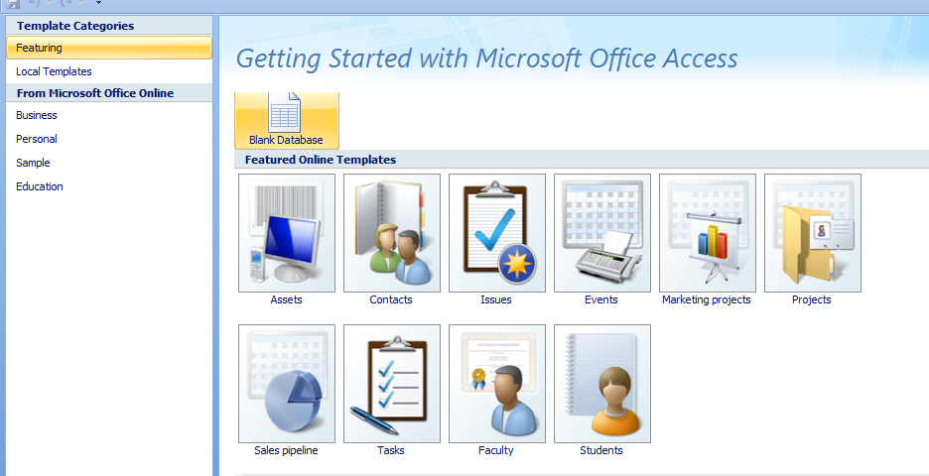
Getting Started MS Access
Start -> Program -> M/S Office -> M/S Access 2007.
Click Blank Database

Slide 3
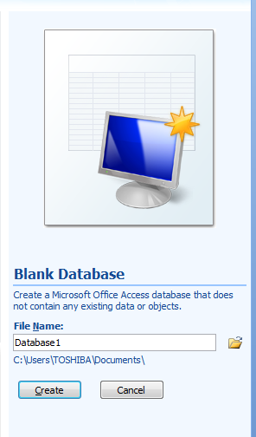
Create database
Fill the File Name
Then, click the Create button

Slide 4
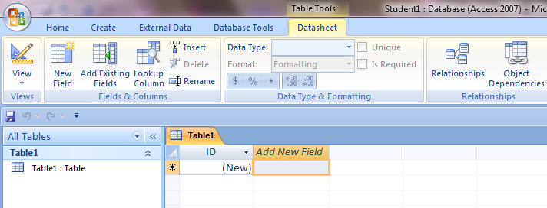
Create database
Fill the Field Name

Slide 5
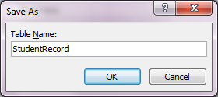
Create database
Then change the design view
Save As Dialog box is apper, and Fill the table name

Slide 6
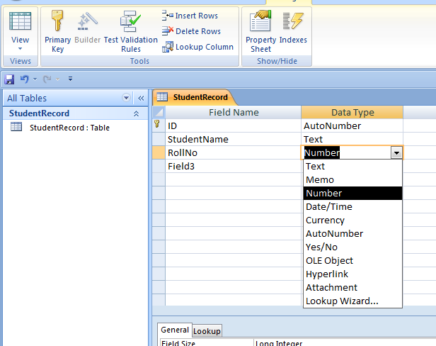
Create database
Fill the Field Name and Choose the Data Type

Slide 7
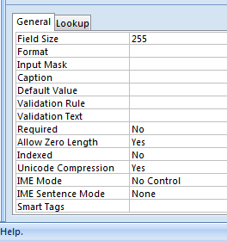
Create Database
If you want to Change the Field Size

Slide 8
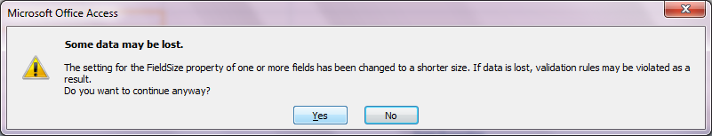
Create database
And then save,
When you save, change the already data may be lost, then click yes.

Slide 9
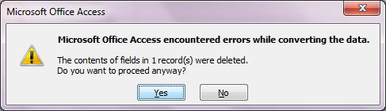
Create database
Then, click Yes

Slide 10
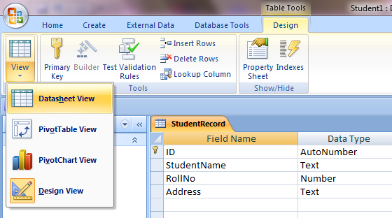
Create database
Click, DataSheet View to insert data in the table

Slide 11
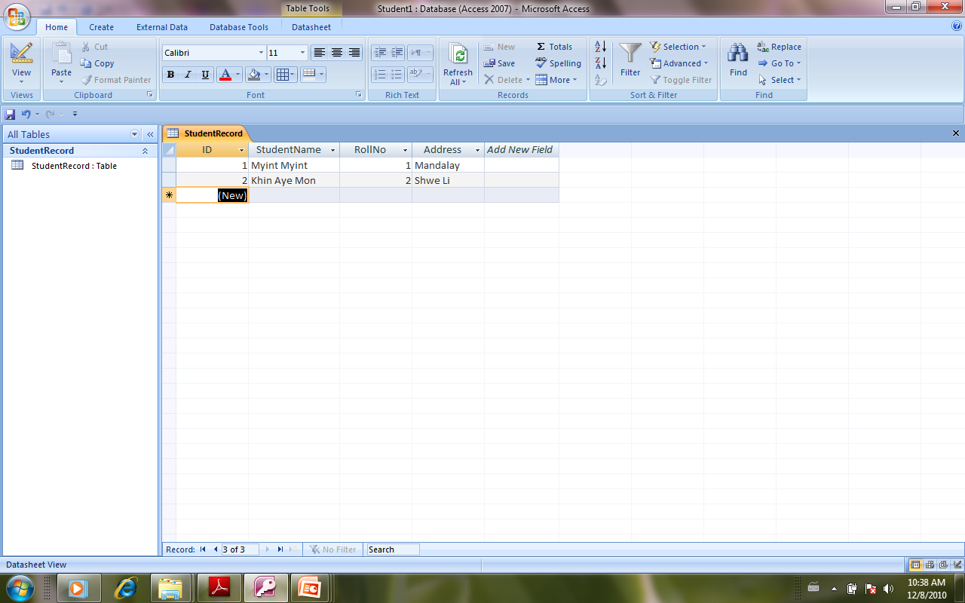
Create Database
Fill the data to the table
Then save

Slide 12

Create Database
If you want to insert the primary key,
Insert row and delete rows

Slide 13
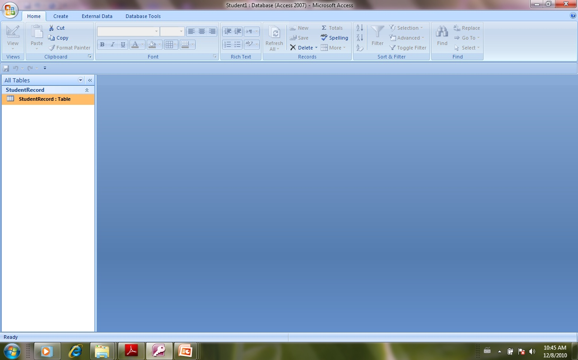
Create Database
After click the close button, you can view with the following figure.

Slide 14
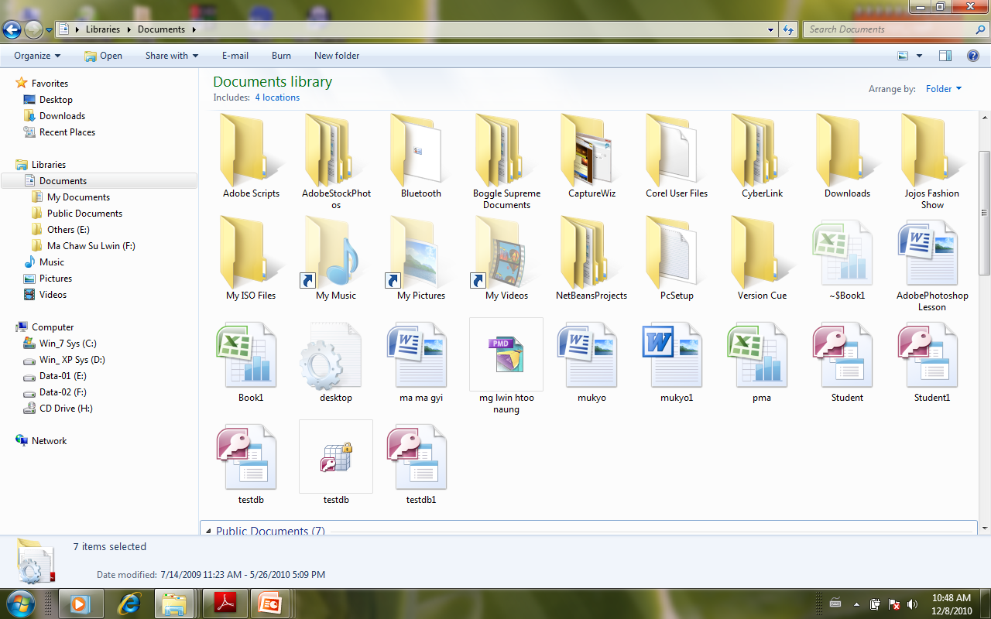
Open the existion database
The default location of database is myDocument

Slide 15
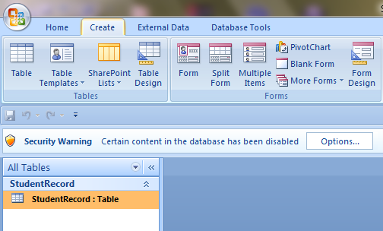
To create another table in the existion database
Click the Create Tag, then click the Table button

Slide 16
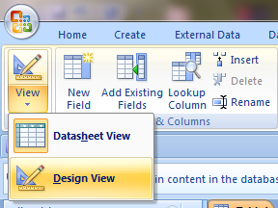
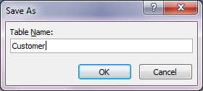
To create another table in the existion database
Then click the design view, save the table name in the Save As dialog box.

Slide 17
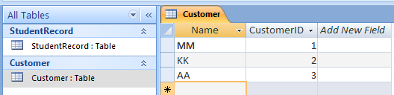
To create another table in the existion database
Then fill the data

Slide 18
Thank you!!!

